Slide 1

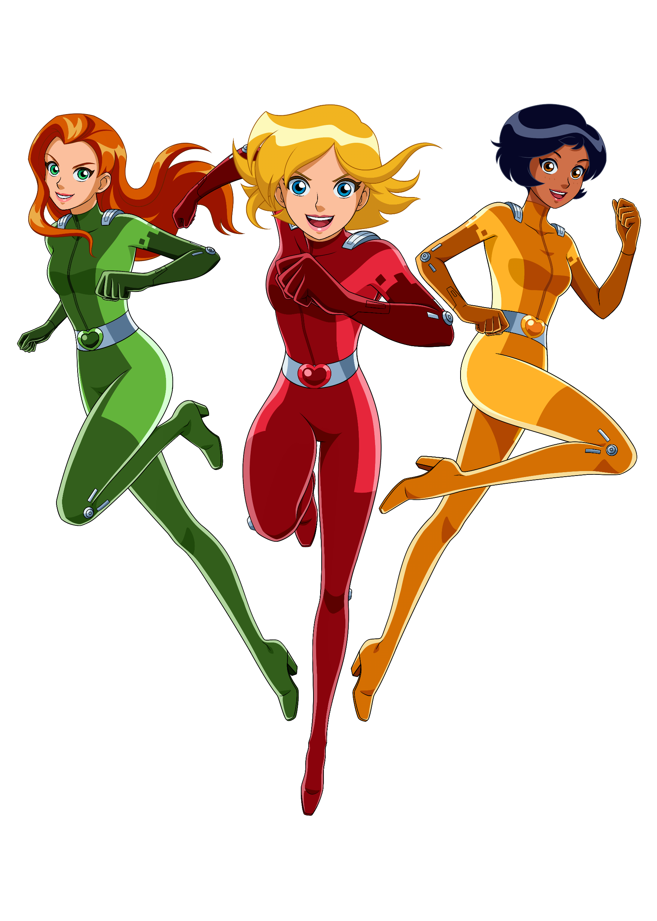


Logo Guidelines

Slide 2



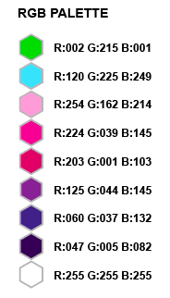
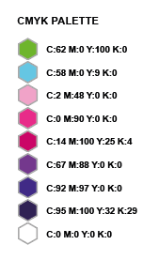
Series 7 Logo
Flat Colour – Available in RGB & CMYK
To be used when only limited colour printing is available.
Full Render –
Available in RGB & CMYK
This is our primary logo and should be used as a first choice, wherever possible (within guidelines).
Line Art – Available in Black & White
To be used when colour printing is not an option.

Slide 3
S7 Logo Guidelines
The Totally Spies! Series 7 logo, pictured below, is only to be used across assets and activations related to Series 7 content.
This logo is the preferred choice for all activity targeting the core Series audience of children aged 6-9, following announcement and logo launch in 2023.
The Series 7 logo should not be used in combination with previous animation, storylines or character designs at any time.
If you wish to use this logo in any way that sits outside of the restrictions detailed here, please contact the Brand team for approval: Lizzy.Gray@ZodiakKids.com and Hannah.Clarke@ZodiakKids.com

Slide 4



S7 Logo Guidelines
When using our logo, DO NOT…
When using our logo, DO…
Leave appropriate clearance space:
Ensure that the logo is not altered or cut off in any way.
Stretch or Squash when resizing:
Always remain within the set dimensions.
Always ensure that the correct colour grading is used:
CMYK for Print, RGB for Digital applications.
Make any adaptations, such as changing colours:
Only use the versions provided within this guide.
Always ensure that the correct legal lines are used:
See next slide for details.
Do not use this logo in conjunction with any other brand or character artwork:
This includes previous Series of Totally Spies!

Slide 5

S7 Legal Lines
Publishing Copyright Line
Every book must include the Full Notice copyright. All books are to be approved by Legal.
Full Notice:
FRENCH
Totally Spies!© [année de commercialisation] Zodiak Kids & Family France
La marque Totally Spies!® et tous les logos, noms et caractéristiques qui y sont associés sont la propriété exclusive de Zodiak Kids & Family France. Tous droits réservés.
D’après la série « TOTALLY SPIES ! » créée et écrite par Vincent Chalvon-Demersay et David Michel.
Création graphique des personnages principaux Luân Vu Ba, basée sur les dessins originaux de Gil Formosa.
Auteurs graphiques des personnages additionels Marie Ciaravino et Stéphane Berry.
Réalisée par Stéphane Berry.
ENGLISH
Totally Spies!© [year of commercialization] Zodiak Kids & Family France
Totally Spies! ® brand and all related logos, names and distinctive likenesses are the exclusive property of Zodiak Kids & Family France. All rights reserved.
Based on the series "TOTALLY SPIES!" created and written by Vincent Chalvon-Demersay and David Michel.
Graphic design of the main characters Luân Vu Ba, based on the original drawings of Gil Formosa. Graphic authors of the additional characters Marie Ciaravino and Stéphane Berry.
Directed by Stéphane Berry.
Merchandising Copyright Line
Legible copyright and trademark notices must be included across all assets, products, packaging and promotional and advertising materials that use the Totally Spies! logo.
Full Notice:
FRENCH
Totally Spies!© [année de commercialisation] Zodiak Kids & Family France
La marque Totally Spies!® et tous les logos, noms et caractéristiques qui y sont associés sont la propriété exclusive de Zodiak Kids & Family France. Tous droits réservés.
ENGLISH
Totally Spies!© [year of commercialization] Zodiak Kids & Family France
Totally Spies! ® brand and all related logos, names and distinctive likenesses are the exclusive property of Zodiak Kids & Family France. All rights reserved.
Abbreviated Notice:
FR: Totally Spies!© [année de commercialisation] Zodiak Kids & Family France
ENG: Totally Spies!© [year of commercialization] Zodiak Kids & Family France
Short Notice:
Only to be used in circumstances where space is incredibly limited:
Totally Spies!©[year of commercialization] ZK&FF
Please use this logo only as supplied. If you require different formats for specific uses, contact the Brand team.

Slide 6

S7 Legal Lines
Promotional Support Related To The Series
These legal lines are to be used on all promotional assets, in advertising, and in any marketing materials related to the series, for example, press releases, flyers, posters and trailers.
Totally Spies!©2023 Zodiak Kids & Family France
In addition to the Zodiak Kids & Family legal line, the name of the partners + logos must be indicated on all media regarding the exploitation and promotion of all or part of each of the Season 7.
With the participation of Gulli and M6
With the participation of Warner Bros. Discovery Kids & Family Latin America + US
With the support of the CNC, Magelis
With the support of Charente county council in partnership with the CNC
With the support of Région Nouvelle Aquitaine in partnership with the CNC
With the support of the MiBAC
When using these lines, logos must be added for all partners, in the same size. In addition to these, the logo of the Italian Ministry of Culture and Zodiak Kids & Family Distribution must also be added.
Please contact the Brand team if you require any of these logos to create new assets.
All relevant assets provided by Brand & Marketing will be delivered with prior approval by partners.
Please submit new any artwork that uses these legal lines to the Brand team for approval.

Slide 7

Series 1-6
The Totally Spies! Series 1-6 logo, pictured below, is to be used across assets and activations related to past Totally Spies! content. This includes all series released prior to 2024.
This logo is the preferred choice for all activity targeting the secondary audience of Millennial and Gen Z fans.
Totally Spies! Series 1 - 6 Legal Lines
Please ensure that you use the relevant copyright line in all activity, assets and materials that use this logo.
Saison 1 et 2 | Season 1 and 2:
© 2002 TF1 – MARATHON ANIMATION
Saison 3 | Season 3:
© 2004 MARATHON ANIMATION – MYSTERY ANIMATION Inc.
Saison 4 | Season 4:
© 2005 MARATHON ANIMATION – MYSTERY ANIMATION Inc.
Saison 5 | Season 5:
© 2007 MARATHON ANIMATION – MYSTERY ANIMATION Inc
Saison 6 | Season 6:
© 2012 MARATHON MEDIA – MARATHON IMAGES

